Slide 1
Creatieve makers [cm³]
Summerschool preparations

Slide 2
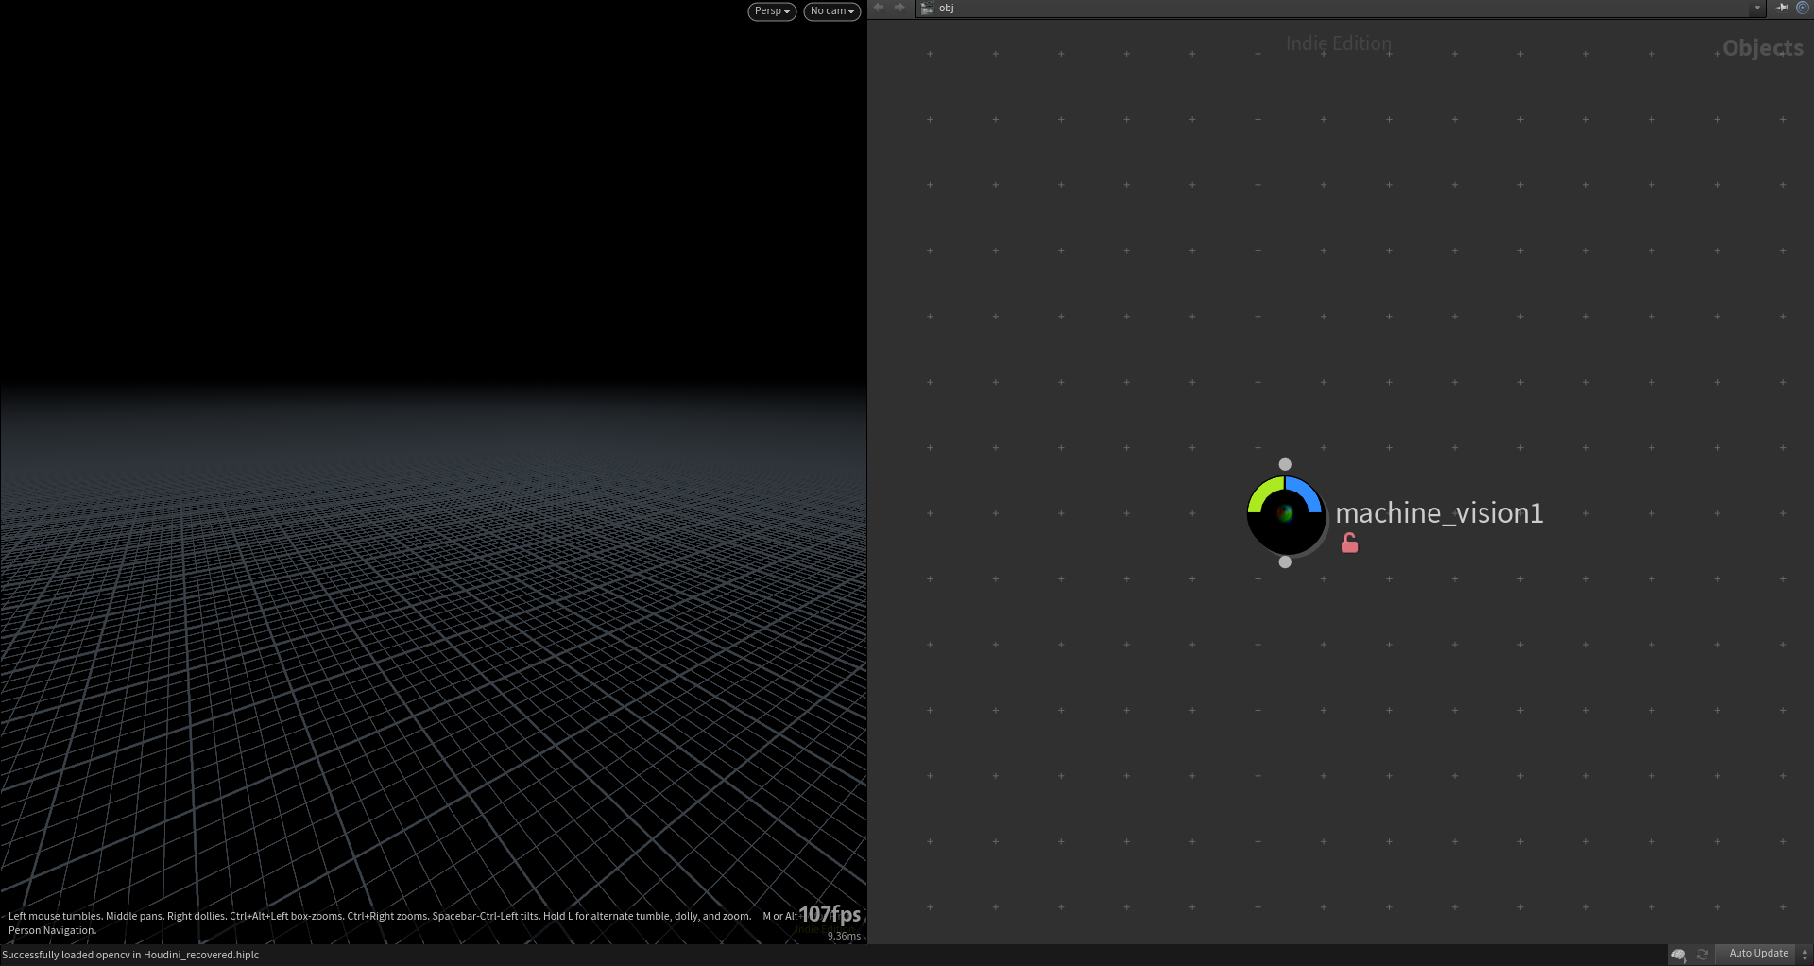
Houdini will be one of the tools used for (geometric) manipulation.
“node”
As Houdini can be complex, custom “nodes” will be provided to act as presets, giving the students lots of relevant operations to play with.

Slide 3
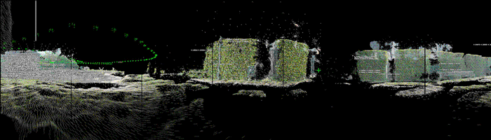
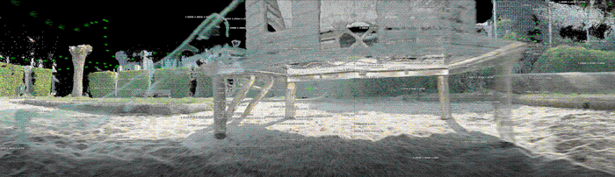
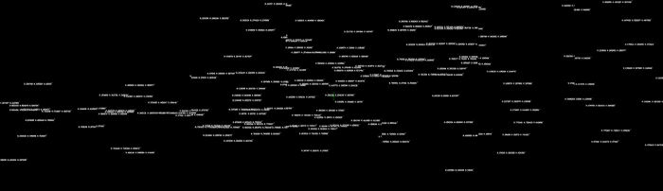
Custom “nodes” allow us to generate new workflows that where previously not possible.
example:
panoramic rendering of pointclouds in OpenGL (Houdini), which is something that is not natively supported. This can now also be combined with annotative elements rendered in a different engine.

Slide 4
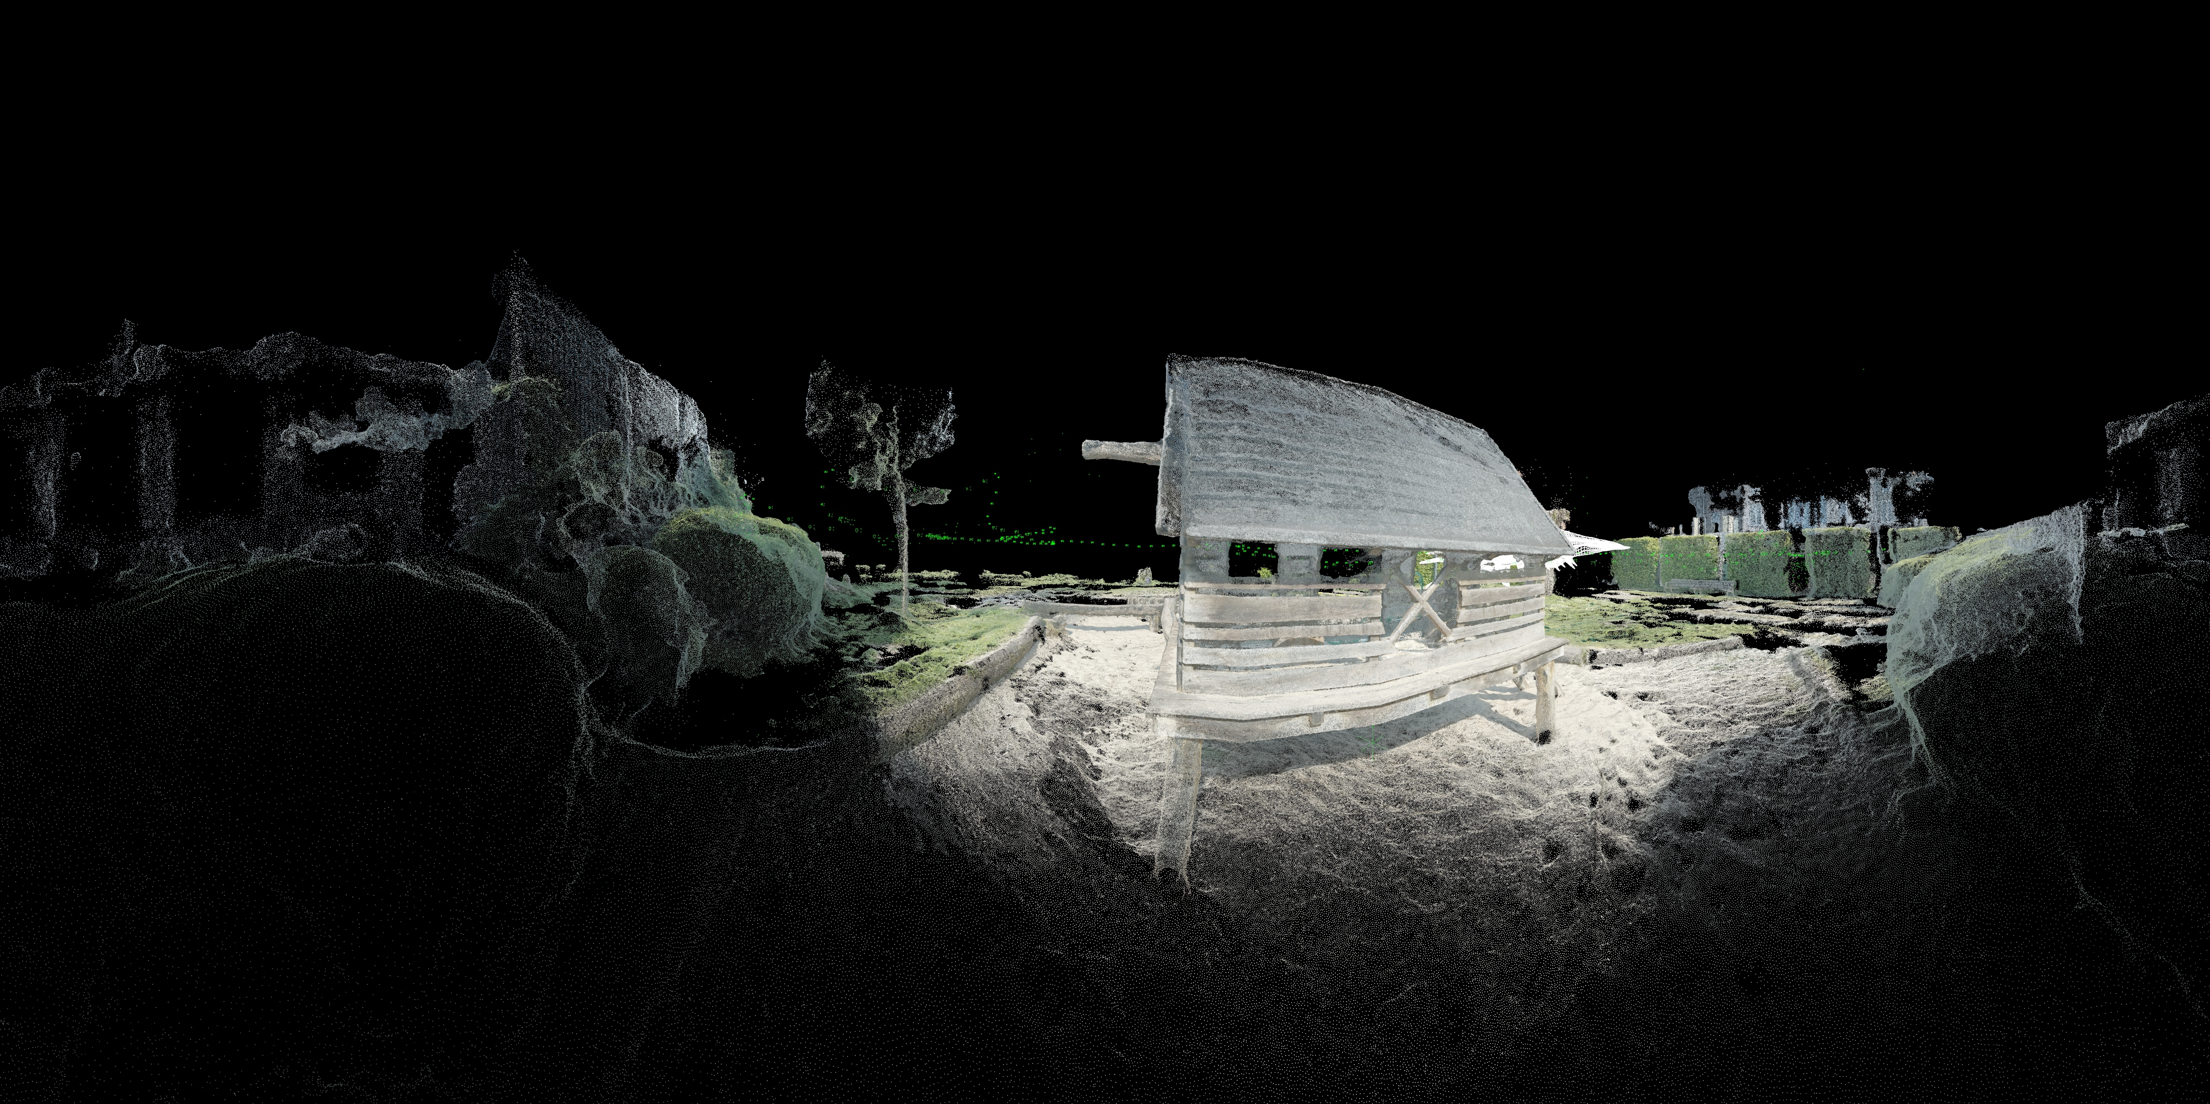
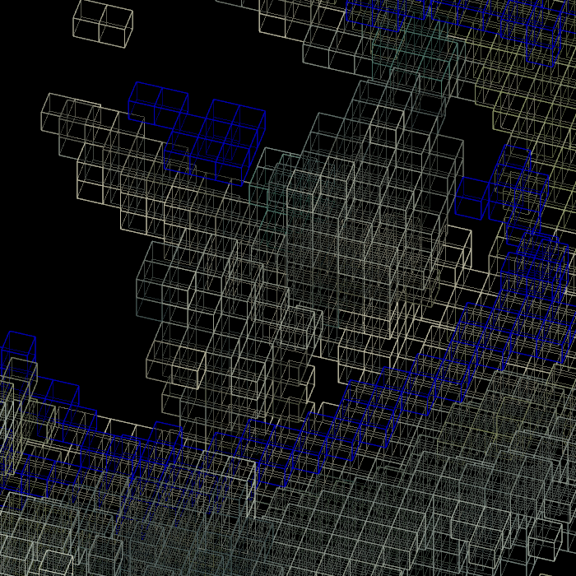
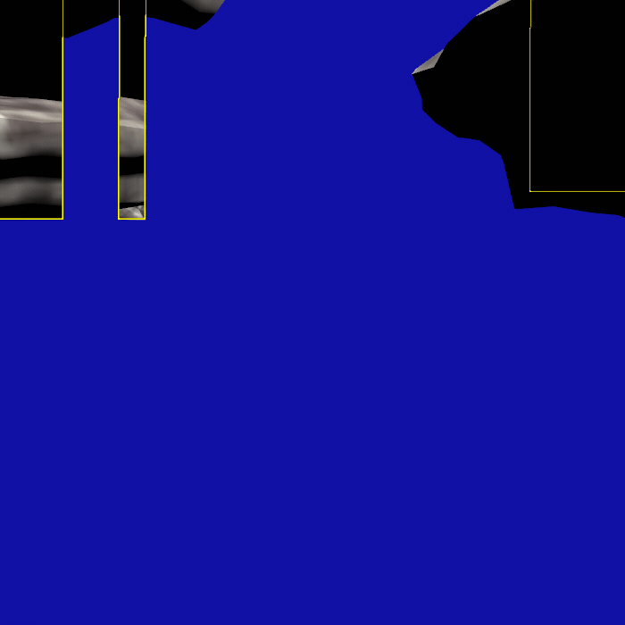
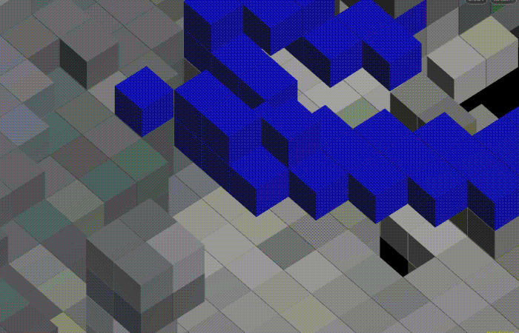
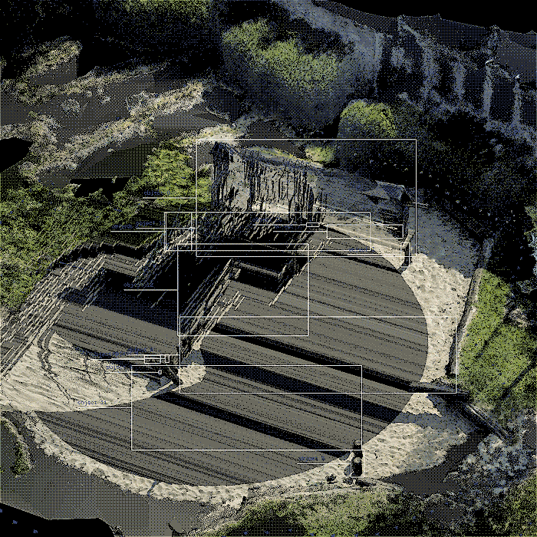
Custom “nodes” allow us to generate new workflows that where previously not possible.
example:
panoramic rendering of pointclouds in OpenGL (Houdini), which is something that is not natively supported. This can now also be combined with annotative elements rendered in a different engine.

Slide 5
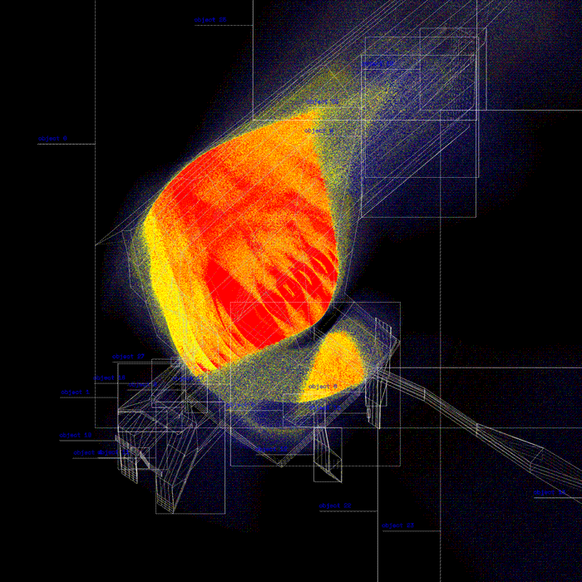
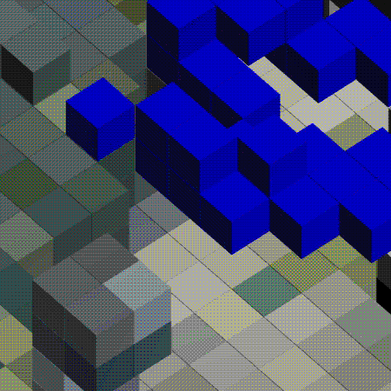
Examples of “nodes” that enable different machine vision or pointcloud operations

Slide 6
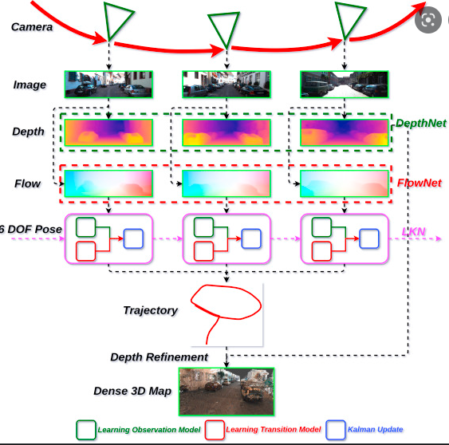
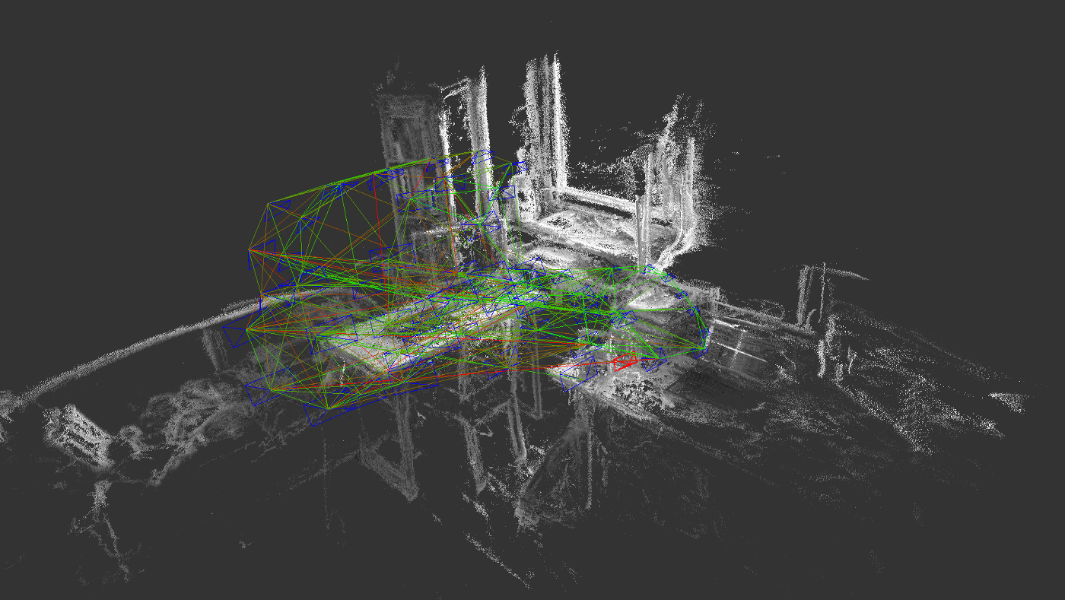
Most geometric capturing methods will result in a pointcloud of some kind. That is why it is important to investigate the possible methodologies of generating pointclouds so students can pick the right option for each case. Some tools include odometry, vslam, scanning, photogrammetry, neural radiance fields etc.
most technique will also be available as custom “nodes” in Houdini

Slide 7
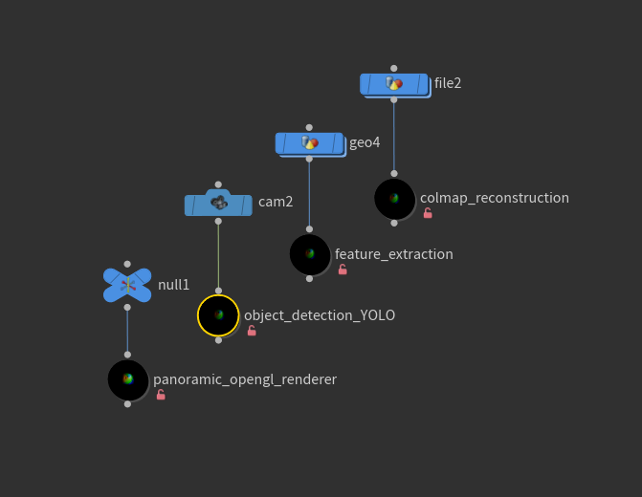
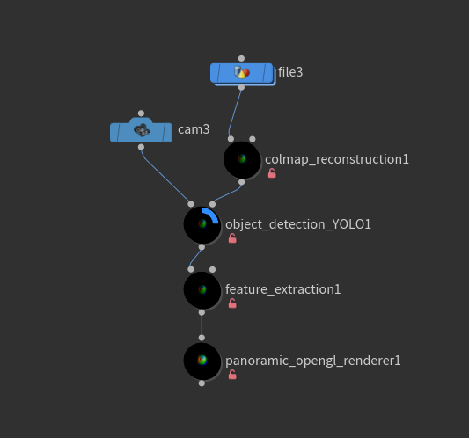
Nodes can run alone, with a custom input, or with each other.
Students will be able to create their own procedural workflows in a way that is easy to understand.
The same operations can also run through as a shell script through
the command line. This is less flexible.

Slide 8
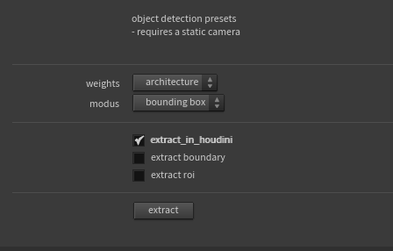
An example of a common node UI.
“Object detection” node UI
A small description of the node function
Which category would you like to detect?
How would you like to visualize this? Segmentation map? centroid? ..
What would you like to do with that data?
Run the node

Slide 9
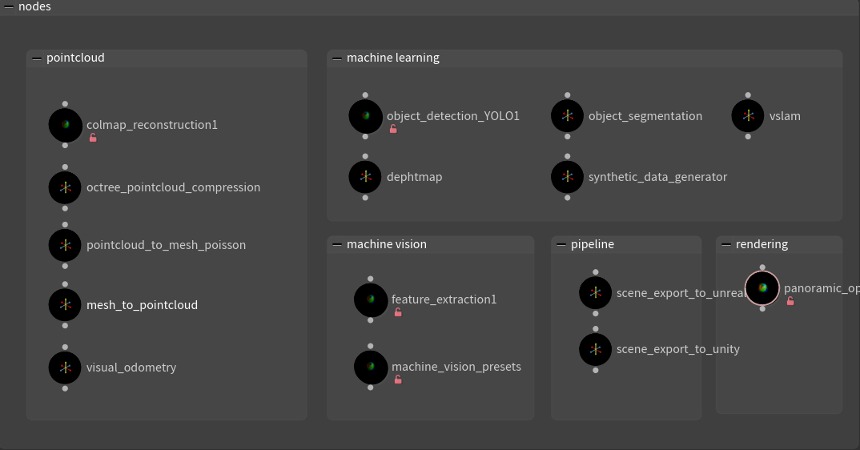
A node roadmap, most of these are WIP’s or are finished.

Slide 10
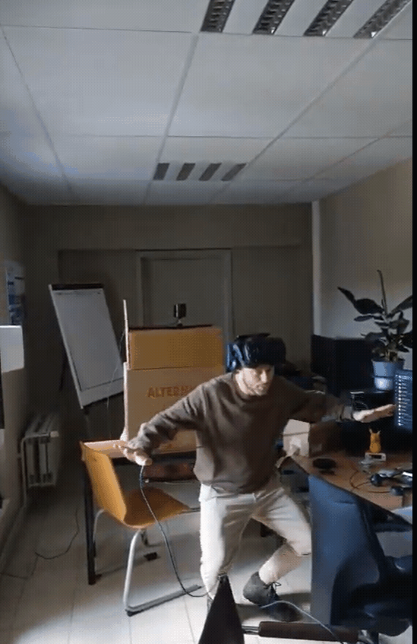
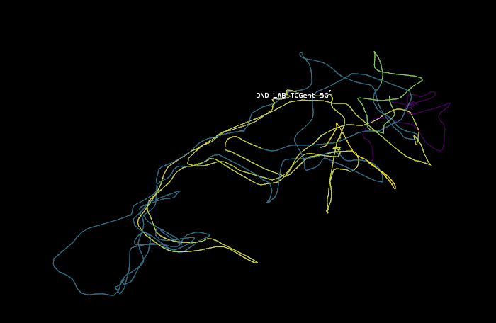
The use of sensory data and custom nodes
Positional tracking with HTC Vive -> custom application that detects wifi signals and their strength -> visualization in Houdini

Slide 11
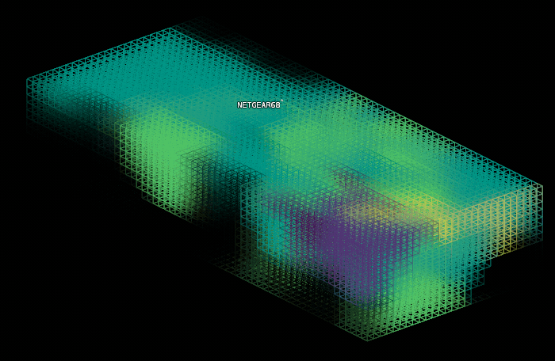
Wifi strength and signal visualization of our workspace

Slide 12
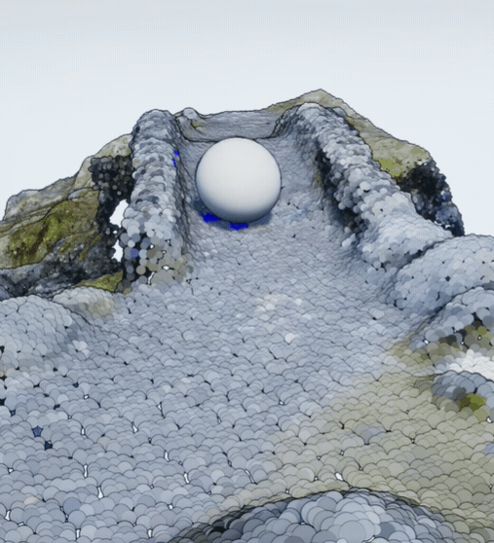
Roadmap
-> finalize custom Houdini nodes
-> more photogrammetry workflows
-> better ML integration
-> more sensory data implementations
-> sensory data from students c02, heartrate, stress..
-> investigate chirp data for spatial reconstruction
-> sensory data on a larger scale with gps?
-> better integration with VR/AR game-engines
->investigate more AR capabilities in game engines
-> build game presets
->…

